Slide 1
Routing in a Nutshell

Slide 2
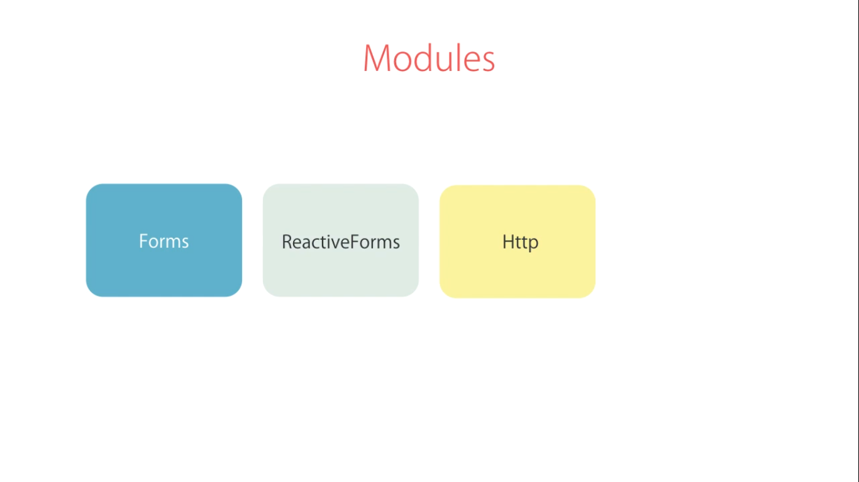

Slide 3
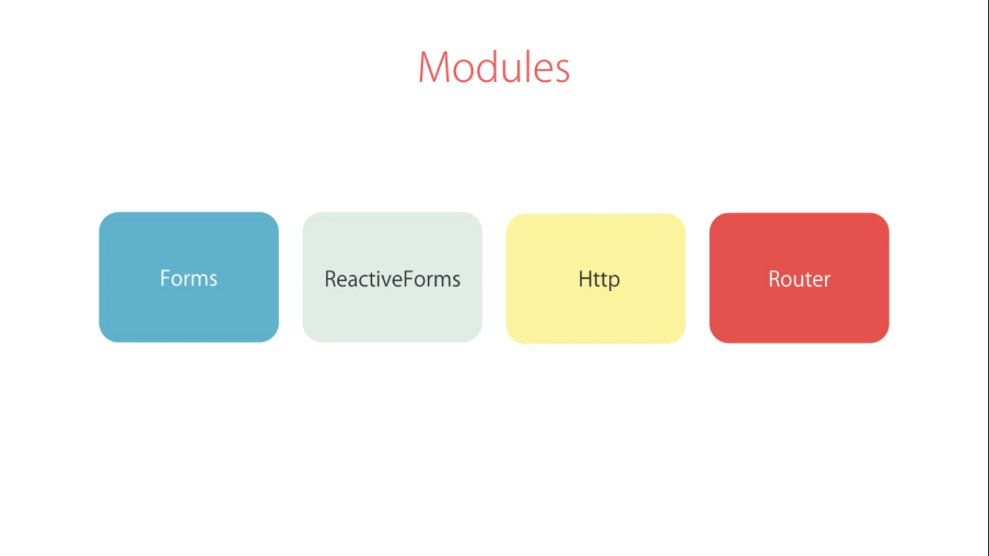

Slide 4
